Slide 1

Security Assessment and Risk Management
Week 11 – Compliance

Slide 2
Compliance begins with audit
You can’t protect it if you don’t know it’s there.
Data discovery
Vulnerability Scanning
Internal Audit
External Audit

Slide 3
Why compliance
Organizations need a method to trust one another when exchanging data or sharing IT resources
A Trust Framework helps this happen with common rules of behavior.
Increases efficiencies, enables processes
Examples:
Credit Card participants – Payment Card Industry Digital Security Standard
Cloud service providers to US Government – FEDRAMP
Health care business associates – HITRUST
Catalogues of control make for efficient validations, and assessment economies of scale
Notes:
Trust frameworks develop a common set of rules to govern a set of business processes between organizations. The value of a common framework is to avoid the need for each organization to conduct due diligence on every other participating organization, while providing common formats for data transfer, rules for processing, and levels of information security.
Leszcz, M. (2017). Trust Frameworks for Identity Systems.
Trust Framework definition I’m using comes from the Identity industry. They developed this useful way to thinking about trust, but have been unsuccessful in

Slide 4
Why not compliance
One organization may have to comply with multiple frameworks with different standards
Control catalogues mooovvveee sllloooooowwwwwllllyyy
(the eight character password)
The Market for Lemons in Assessments
Unable to judge quality, it’s a race to the bottom
Notes:
For example, a health care business may take credit cards. A financial institution may have a federal contract.
Passwords – ISO – Easy to remember, not subject to dictionary attacks.
FISMA (SP800-53 Appendix F) has five requirements for passwords
PCI-DSS – 24 requirements for passwords (at least 7 characters, alphanumeric)
How old are the components of the PCI-DSS password complexity standard? It’ll be turning 40.
Proposal for changes in SP800-53 – reduce it to 30 controls!
Lipner, S., Lampson, B., (2016) Risk Management and the Cybersecurity of the U.S.
Government: Input to the Commission on Enhancing National Cybersecurity
retrieved from https://www.nist.gov/sites/default/files/documents/2016/09/16/s.lipnerb.
lampson_rfi_response.pdf

Slide 5

Notes:
Take a large org with a FISMA ATO, PCI-DSS, SOC 2 Type II, ISO 27001:2013– the full boat of security certs, signaling heavily that YOU SHOULD TRUST US. WE KNOW WHAT WE ARE DOING, AND HAVE PROVEN IT TO ALL THE AUDITORS IN THE WORLD.
This org was Equifax.
Come to think about it, every hack that stole credit cards was of a PCI compliant org.
Verizon Business PCI-DSS report – in 2017 52.5% of PCI-DSS certified orgs were compliant six months later. (down from 55.4% in 2016, but up from 11% in 2011, so yay?)

Slide 6
Complex Adaptive Systems
Self-similarity, chaos, and the butterfly effect.
Every human in an organization has their own set of schema or rules of behavior
So does every team / department / division
They communicate with each other and establish “shadow systems”
These systems are non-linear.
Everything is headed toward chaos - and through chaos, adaptation
.
Notes:
There’s a theory that some systems don’t work like gears/cogs, or follow common, predictable patterns. Some are bordering on the “edge of chaos” – a system almost to the point of falling apart – and when it is in this state it changes and grows. It happens when water changes state (ice to water to gas). It happens in evolution.
I think (as do others) that it happens in organizations.
So what happens to an organization’s compliance program when it changes? What happens to its security outcomes?

Slide 7
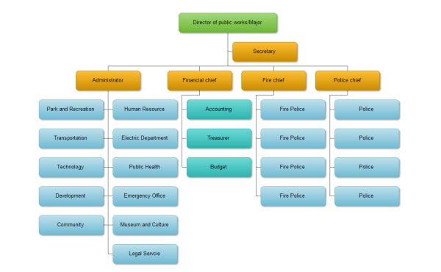

Hierarchical v. Complex
How we think it works
How it actually works

Slide 8
Evolution to the Edge of Chaos
“The behavior of some simple, deterministic systems can be impossible, even in principle, to predict in the long term.”
Complexity: A Guided Tour, M. Mitchell (2009)
“The concurrency of multiple, and often conflicting performance measures and reward structures, which define the goals that decision makers attend to is a central characteristic of real organizations.”
Models of complex adaptive systems in strategy and organization research (O. Baumann, Mind & Society, 2015)

Slide 9
Types of Data - PCI
Payment Card Industry standards govern the use and security of credit card data. Since the PCI Council is not a government entity, their Data Security Standards (DSS) are a contractual obligation, rather than a legal requirement.
It is still critical to maintain compliance as the ramifications are huge (aside from a breach) – the organization losing their ability to accept credit cards because issuers have blacklisted them, for example. That’s kind of a big deal for ecommerce or retail organizations.
Data Security Standards are in a constant state of review. Revisions are released periodically and become mandatory on a timeframe. We’re currently (as of March 2022) mandated to comply with PCI DSS 4

Slide 10


Types of Data - PCI
Responsible for managing the PCI DSS and certifying QSAs and ASVs
Responsible for enforcing and monitoring merchant compliance with the PCI DSS
CREDIT CARD SECURITY
Bank
Merchant
Communicates and educates merchants on PCI DSS and reports compliance status to Card Associations
Responsible for safeguarding credit card data and complying with the PCI DSS
Multiple people play a role in the PCI process because PCI is a contract between the Merchant (the person accepting credit cards), the Issuer (credit card companies), an Acquiring Bank (the bank performing the transactions), and the PCI Council (the governing body over standards.)

Slide 11
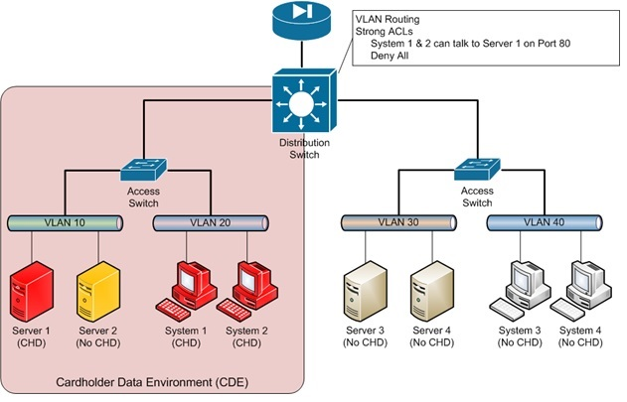

Slide 12
Types of Data - PCI
Anyone that takes plastic in any form must be in compliance with the standards. Any system that stores, processes, or transmits card data is in scope and must comply with current DSS.
Sometimes, in the course of an audit, it will be discovered that card data is being sent over an unknown system (“Oh, btw, did you know Tina in Sales is taking credit cards over the phone?”) – when that happens, it “pulls” the entire system “in scope.” Now the ENTIRE phone system must be PCI compliant (Tina’s phone and everything it connects to.)

Slide 13
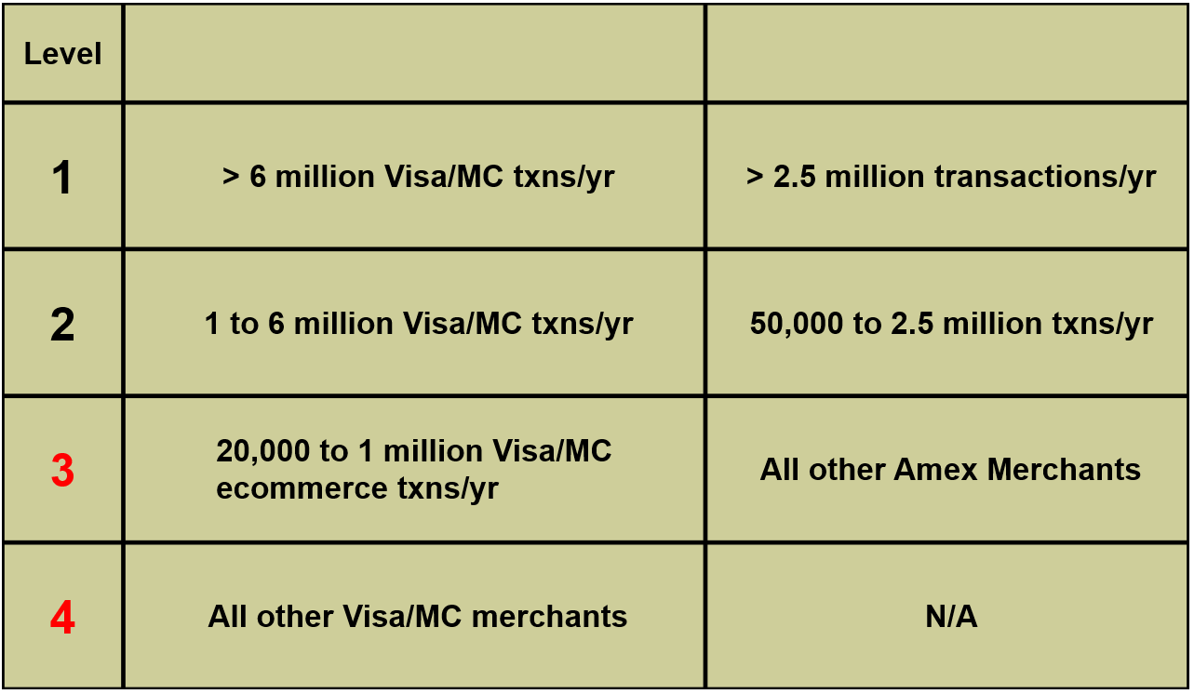
Types of Data - PCI
The number of transactions a merchant takes determines their level.

Slide 14
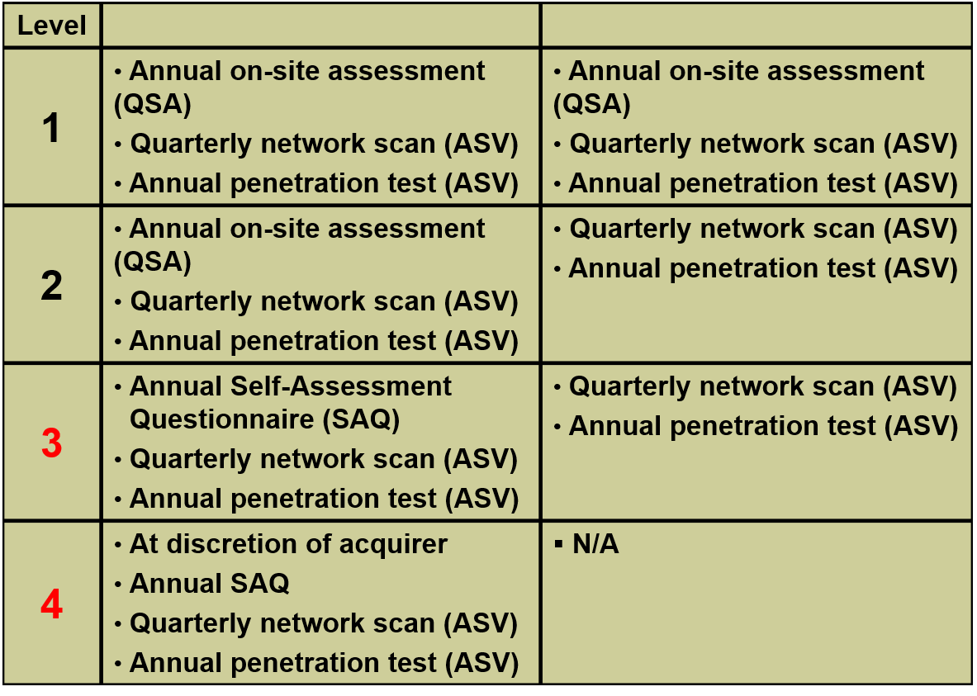
Types of Data - PCI
The merchant’s level determines what types of audits they face.

Slide 15
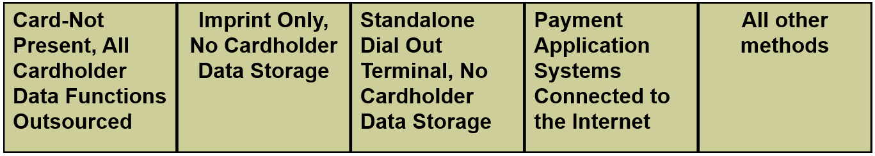
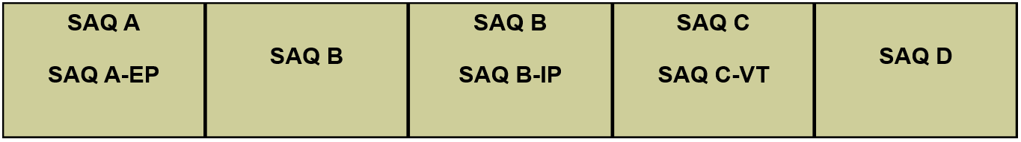
Types of Data - PCI
The Self-Assessment Questionnaire is a form that describes various controls. The merchant marks down whether or not they comply with the standard, and are audited against that. For example, the SAQ may contain the following provision: “All authentication utilizes passwords of at least 7 characters.” The potential options are Yes, No, or N/A. There is no “maybe” “sometimes” or “I don’t know”
There are multiple types of SAQs. The SAQ D described roughly 330 controls to comply. The SAQ B, about 40.

Slide 16
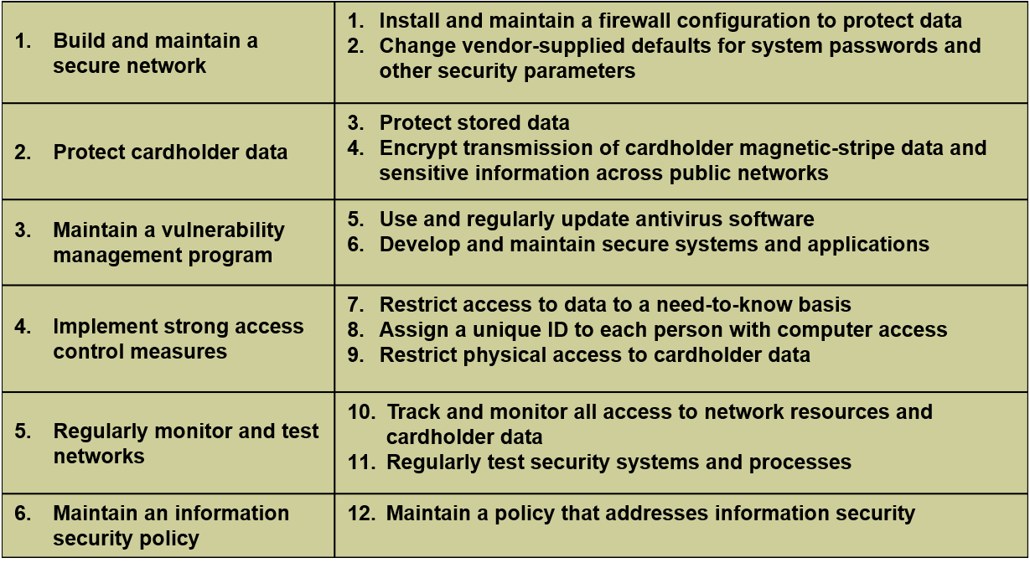
Types of Data - PCI
The PCI DSS is full of a lot of controls. However, the basic six objectives have been around since DSS 1.0 with the accompanying twelve goals.

Slide 17
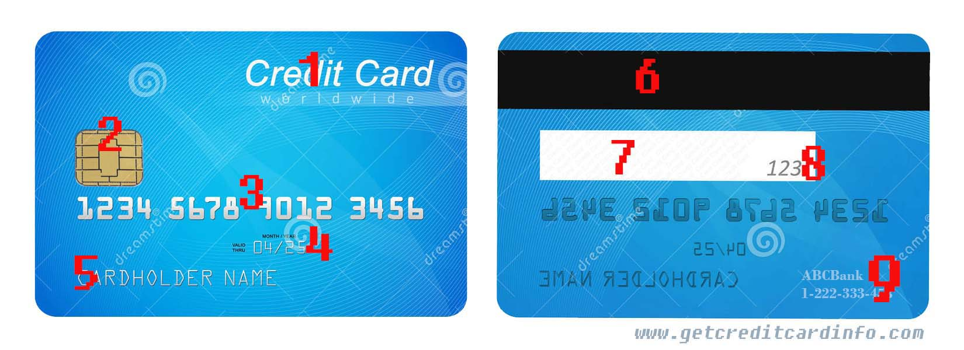

Slide 18
Types of data - PCI
PCI data breaks down into two groups of information:
Cardholder Data (CHD) – Generally the info on the front of the card. Nothing in PCI DSS forbids storage of this data.
Primary Account Number (PAN)
Truncated PAN: up to first 6 and last 4
Cardholder Name (when kept with PAN)
Expiration Date (when kept with PAN)
Service Code (when kept with PAN)
Sensitive Authentication Data (SAD) – Generally on the back of the card. NEVER STORE SAD after authorization.
Full magnetic stripe data or equivalent on a chip
CAV2/CVC2/CVV2/CID
PIN/PIN block

Slide 19
Types of Data - PCI
Because the audit process is lengthy and requires a high level of knowledge, audits are usually done by individuals in Auditing or a Compliance Officer in an IA organization. PCI also certifies auditors. ISA are internal security assessors. QSA (qualified security assessors) are external auditors, outsourcing the compliance audit.
A QSA can:
Validate your scope of compliance
Prepare gap assessments
Perform a full PCI assessment
And prepare the Report on Compliance (ROC)
Assist with the Attestation of Compliance (AOC)
Speak with your team and with campus leaders

Slide 20
Types of Data - HIPAA
The Health Insurance Portability and Accountability Act of 1996 brought a lot of changes to the healthcare industry. For our purposes, we are concerned wit the regulations that govern the handling of health information. This is Title II HIPAA Privacy, Security, and Enforcement. This clause establishes Personal Health Information (PHI).
a patient's name, address, birth date and Social Security number;
an individual's physical or mental health condition;
any care provided to an individual; or
information concerning the payment for the care provided to the individual that identifies the patient, or information for which there is a reasonable basis to believe could be used to identify the patient.
This applies only to data that is not “de-identified” aka sanitized, anonymized, etc. If it contains no identifiable information it is not subject to HIPAA requirements.

Slide 21
Types of Data - FERPA
The Family Educational Rights and Privacy Act (FERPA) (20 U.S.C. § 1232g; 34 CFR Part 99) is a Federal law that protects the privacy of student education records. The law applies to all schools that receive funds under an applicable program of the U.S. Department of Education.
FERPA gives parents certain rights with respect to their children's education records. These rights transfer to the student when he or she reaches the age of 18 or attends a school beyond the high school level. Students to whom the rights have transferred are "eligible students."

Slide 22
Types of Data - FERPA
Parents or eligible students have the right to inspect and review the student's education records maintained by the school. Schools are not required to provide copies of records unless, for reasons such as great distance, it is impossible for parents or eligible students to review the records. Schools may charge a fee for copies.
Parents or eligible students have the right to request that a school correct records which they believe to be inaccurate or misleading. If the school decides not to amend the record, the parent or eligible student then has the right to a formal hearing. After the hearing, if the school still decides not to amend the record, the parent or eligible student has the right to place a statement with the record setting forth his or her view about the contested information.

Slide 23
Types of Data - FERPA
FERPA allows schools to disclose those records, without consent, to the following parties or under the following conditions (34 CFR § 99.31):
School officials with legitimate educational interest;
Other schools to which a student is transferring;
Specified officials for audit or evaluation purposes;
Appropriate parties in connection with financial aid to a student;
Organizations conducting certain studies for or on behalf of the school;
Accrediting organizations;
To comply with a judicial order or lawfully issued subpoena;
Appropriate officials in cases of health and safety emergencies; and
State and local authorities, within a juvenile justice system, pursuant to specific State law.

Slide 24
Types of Data - FERPA
Schools may disclose, without consent, "directory" information such as a student's name, address, telephone number, date and place of birth, honors and awards, and dates of attendance. However, schools must tell parents and eligible students about directory information and allow parents and eligible students a reasonable amount of time to request that the school not disclose directory information about them. Schools must notify parents and eligible students annually of their rights under FERPA. The actual means of notification (special letter, inclusion in a PTA bulletin, student handbook, or newspaper article) is left to the discretion of each school.

Slide 25
Types of Data - GDPR
Breach Notification
Under the GDPR, breach notification will become mandatory in all member states where a data breach is likely to “result in a risk for the rights and freedoms of individuals”. This must be done within 72 hours of first having become aware of the breach. Data processors will also be required to notify their customers, the controllers, “without undue delay” after first becoming aware of a data breach.

Slide 26
Types of Data - GDPR
Right to Access
Part of the expanded rights of data subjects outlined by the GDPR is the right for data subjects to obtain from the data controller confirmation as to whether or not personal data concerning them is being processed, where and for what purpose. Further, the controller shall provide a copy of the personal data, free of charge, in an electronic format. This change is a dramatic shift to data transparency and empowerment of data subjects.

Slide 27
Types of Data - GDPR
Right to be Forgotten
Also known as Data Erasure, the right to be forgotten entitles the data subject to have the data controller erase his/her personal data, cease further dissemination of the data, and potentially have third parties halt processing of the data. The conditions for erasure, as outlined in article 17, include the data no longer being relevant to original purposes for processing, or a data subjects withdrawing consent. It should also be noted that this right requires controllers to compare the subjects' rights to "the public interest in the availability of the data" when considering such requests.

